Slide 1
RYM SHOK Cook Book
Re-design pilot in Oulu and
spatial analysis of some new schools

Slide 2
Zoning of spaces.
All spaces have their own character
In this analysis the focus if in traffic and movement in space
Focus can be also usage in a moment of time because character may vary by time
In good architecture connections between spaces of different character should be between closest ones to get comfortable feeling of space.
Private zone
Half-private zone
Half-public zone
Public zone
- New construction
If this has not been considered on original architectural design the spaces do not operate as they ought to. In renovations to make perfectly operating spaces the failure in hierarchy of spaces have to be corrected by new constructions.

Slide 3
Plan of old cell in The Oulu school.
In this Pilot area we have five accesses to the non-operating common spaces

Slide 4
Existing private zone.
Private zone
Half-private zone
Half-public zone
Public zone
- New construction
Classroom are considered as private space, because only closed group of people are using it.

Slide 5
Existing public zone.
Private zone
Half-private zone
Half-public zone
Public zone
- New construction
Corridors are considered as Public spaces, because all the people at school are using it with out any restrictions.

Slide 6
Existing public zone. Combination conflict.
Private zone
Half-private zone
Half-public zone
Public zone
- New construction
- Combination conflict
The learning corridor spaces of learning cells do not operate at all because room can not have two character at the same time..
Sliding walls have not been used because we can not connect two spaces of totally different character. The leap from character to an other has to be between the closest ones. Quantum Leap does not work in architecture.
Leaning corridor concept works well in University surroundings when the students are adults.

Slide 7
Existing traffic at public zone.
Private zone
Half-private zone
Half-public zone
Public zone
- New construction
If one space seem to have two characters the more public one dominates.
If we leap over one character the space combination may still work somewhat, but the spatial feeling is not the perfect one.

Slide 8
New construction.
Private zone
Half-private zone
Half-public zone
Public zone
- New construction
In this case the correction to spatial hierarchy is achieved by minor new construction.
The inner garden in the middle is made to winter garden (half warm space) and two new corridors are made to library and language studio spaces.

Slide 9
New construction.
Private zone
Half-private zone
Half-public zone
Public zone
- New construction
The non-operating learning corridors are sliced apart from corridor spaces by glass walls.
By this minor change we have made transformation of four spaces from Learning Corridor to Learning Community of each Cell.

Slide 10
New public zone.
Private zone
Half-private zone
Half-public zone
Public zone
- New construction
After the change the public corridor spaces have self explanatory character.
There is on going discussion : What is the character of subject orientated classroom?

Slide 11
Traffic at the new public zone.
Private zone
Half-private zone
Half-public zone
Public zone
- New construction
Public traffic is now concentrated to corridor spaces.
There is on an other going discussion : What is the character of multiuse spaces?

Slide 12
New half-private and half-public zones of the school.
Private zone
Half-private zone
Half-public zone
Public zone
- New construction
After the change we have got rid of quantum leaps and there fore spaces can operate as they should.
The perfect solution would be if we had half public space between public and semi-private. Vestibule for shoes and clothes would have done the trick, but there was not enough space and fire-regulators demanded the clothes to be located on a classrooms.

Slide 13
New life of “cell” school.
Private zone
Half-private zone
Half-public zone
Public zone
- New construction
After the change we have fully functional Learning communities in Cells. The old folding walls between Leaning Communities and class rooms can be opened because there is no interference of traffic.
To have perfect learning spaces we have also payed attention to interior solutions of classrooms and learning communities.

Slide 14
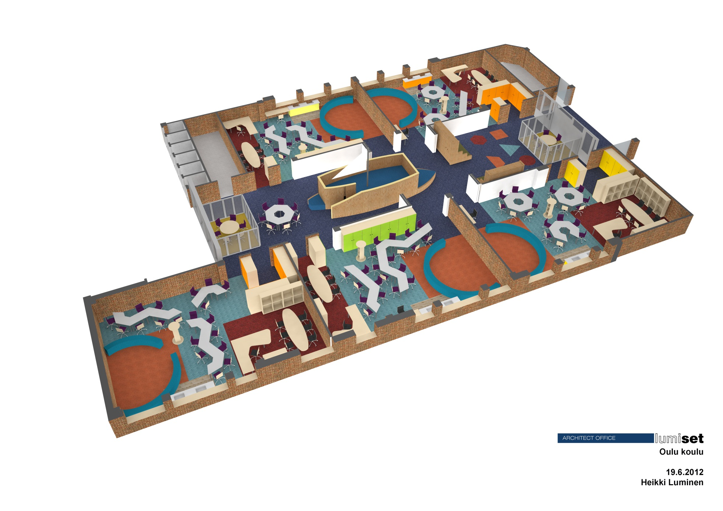
Informal furnishing of new “cell”
Teacher has standing table in the middle of the classroom.
Pupils tables can be formed to many different setting depending on need.
Closets have magnetic laminate surface to give more wall for paper notes
Special school lightning is added to space to able mood change when needed.

Slide 15
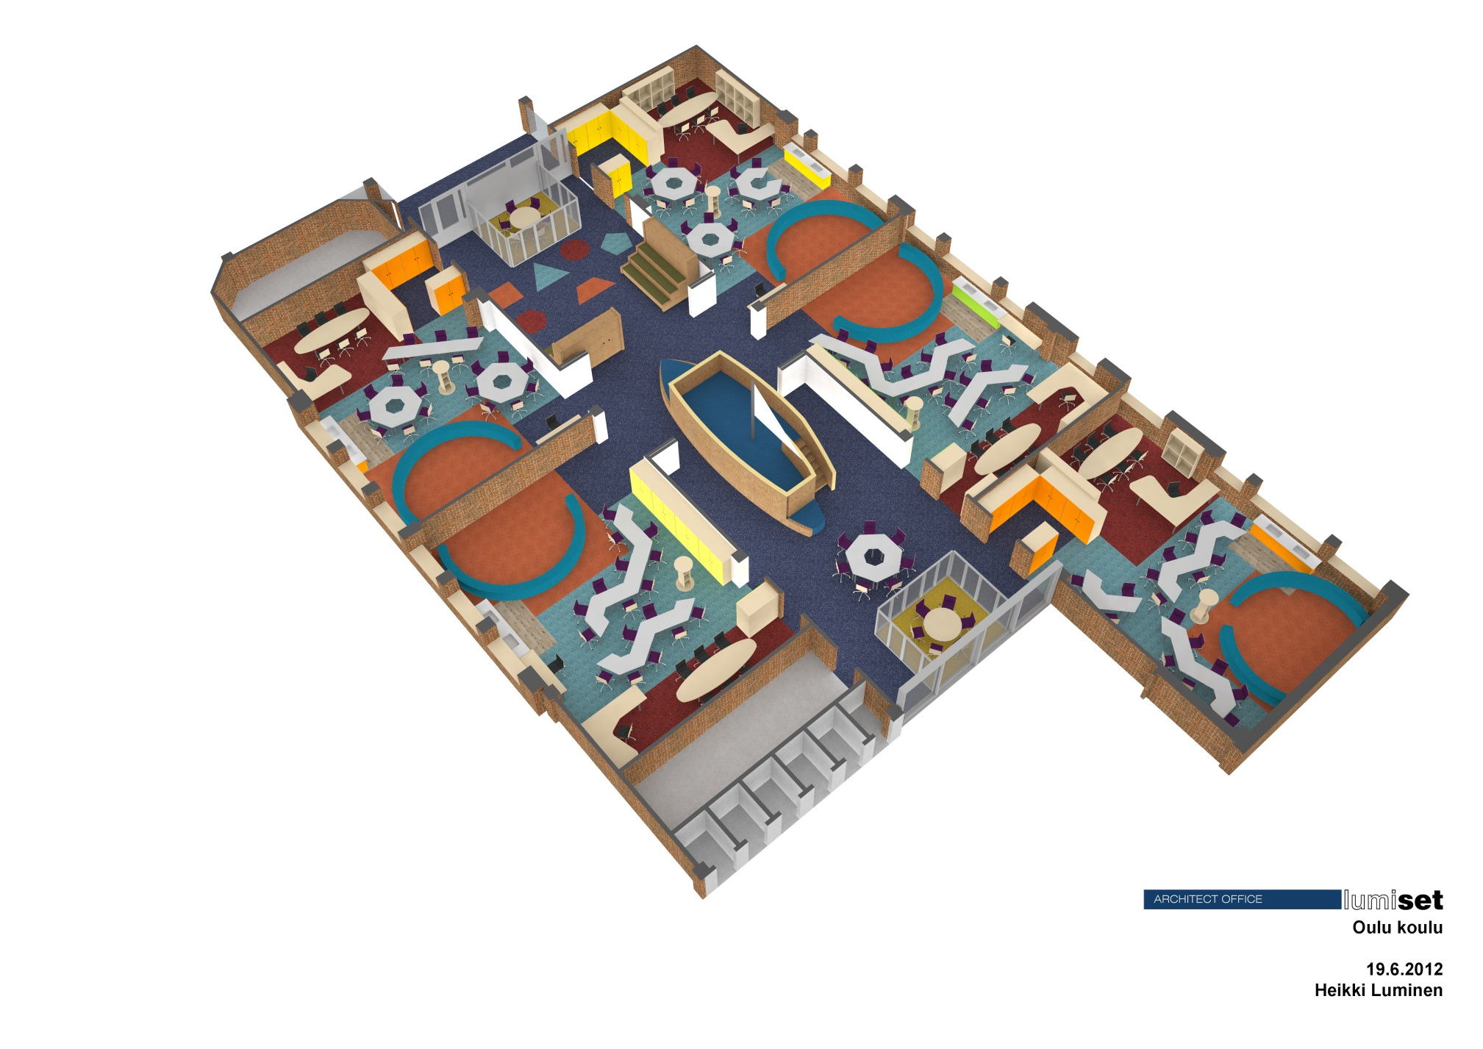
Informal furnishing of new “cell”
Carpeting is also noise insulation surface.
Ceiling has 100% cover of high class noise insulation material.
Small study booths were added to pupils with concentration problems.
Coloring of carpet helps teachers to form different small study groups.
Boat form infromal small group area was designed to the middle. Floor in it is wrestling carpet. Whole class (24+1) can be seated to boat.
Sliding walls can finally be oppened.

Slide 16
Spatial analysis of some new schools
Tilahierkia-analyysin tarkoitus on kartoittaa tilojen suhdetta toisiinsa ja tilajaon vaikutusta rakennuksen joustavuuteen muuttuvassa pedagogisten ratkaisujen ympäristössä.
Selvityksen kohteena ovat seuraavat koulut (turkoosesita aineisto on saatu tähän mennessä)
Sepän lukio “Plaza”, Jyväskylä
Ritaharjun monitoimitalo, Oulu
Metsokankaan koulu, Oulu
Latokartanon peruskoulu, Helsinki
Kauhajoen koulukeskus, Kauhajoki
Lopen yläkoulu ja lukio, Loppi
Järvenpään lukio, Järvenpää
Martti Ahtisaaren koulu, Kuopio
Seminaarin koulu, Hämeenlinna (aineiston analyysi materiaali tekeillä)
Tilahierarkiaa tarkastellaan yksittäisen hetken näkökulmasta, liikkumiskokemuksen näkökulmasta ja yleisellä tasolla. Tällä metodilla kartoitetaan moniluonteisten tilojen määrä ja laatu sekä monikäyttöisten tilojen vaikutus opettamiseen ja oppimiseen.
CookBook kokoaa lukuisten yksittäisiä perus- ja aineopetustiloja käsittävän tutkimuksen tulokset, mutta uutena asiana sen yhteydessä tutkitaan tilahierarkian ja monikäyttöisten tilojen vaikutusta oppimiseen ja opettamiseen. Cook Book ottaa myös kantaa modernien tietoteknisten ratkaisujen tuomiin muutospaineisiin muuttuvassa oppimaisemassa.

Slide 17
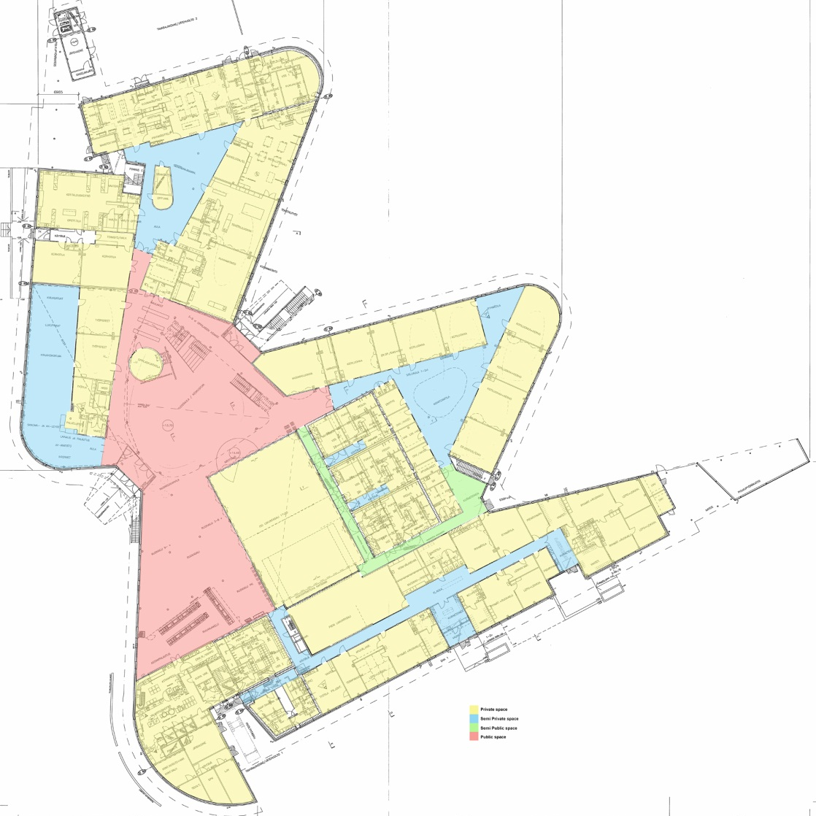
Spatial analysis of some new schools
Ritaharjun monitoimitalo, Oulu
Arkk. Hannu Jaakkola

Slide 18
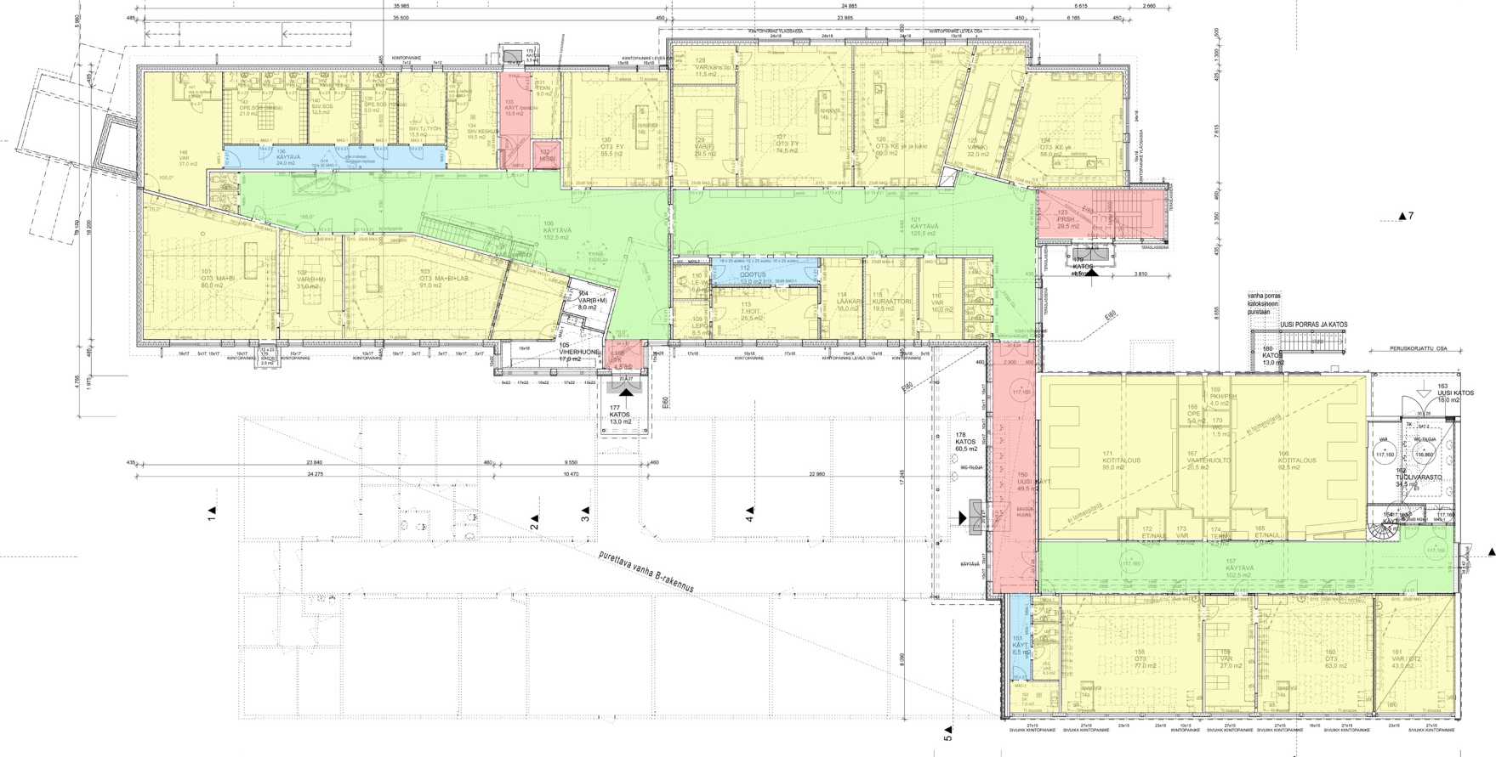
Spatial analysis of some new schools
Lopen yläkoulu ja lukio, Loppi
Arkk. Sanna Okko, RCO Oy

Slide 19
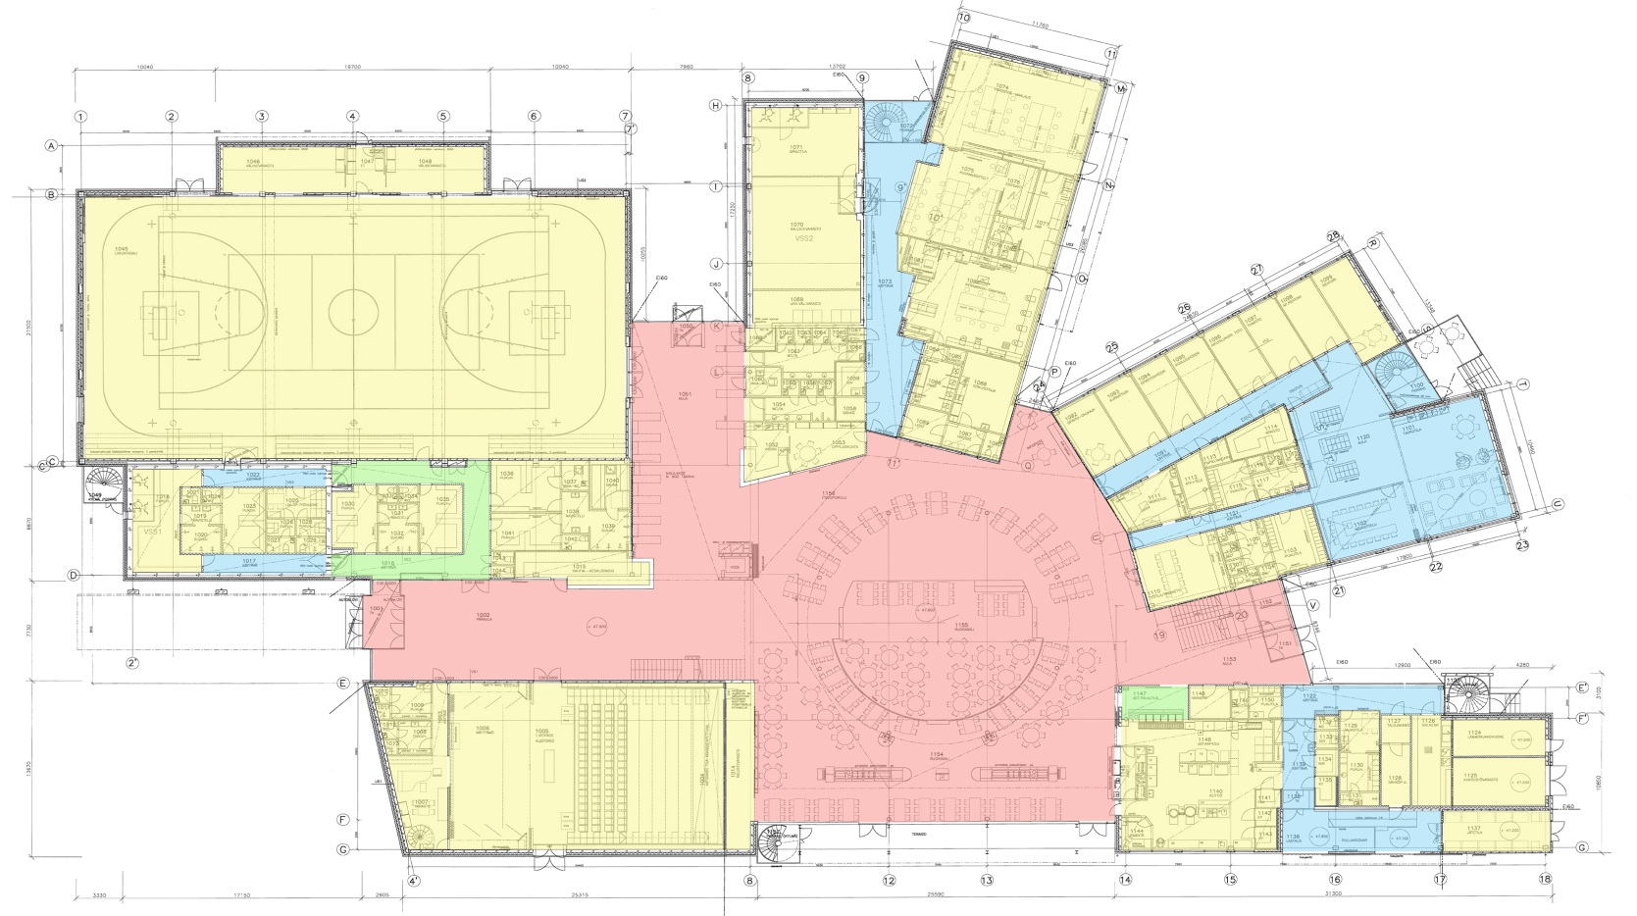
Spatial analysis of some new schools
Järvenpään lukio, Järvenpää
Arkk tsto Aarne von Boehm Oy

Slide 20
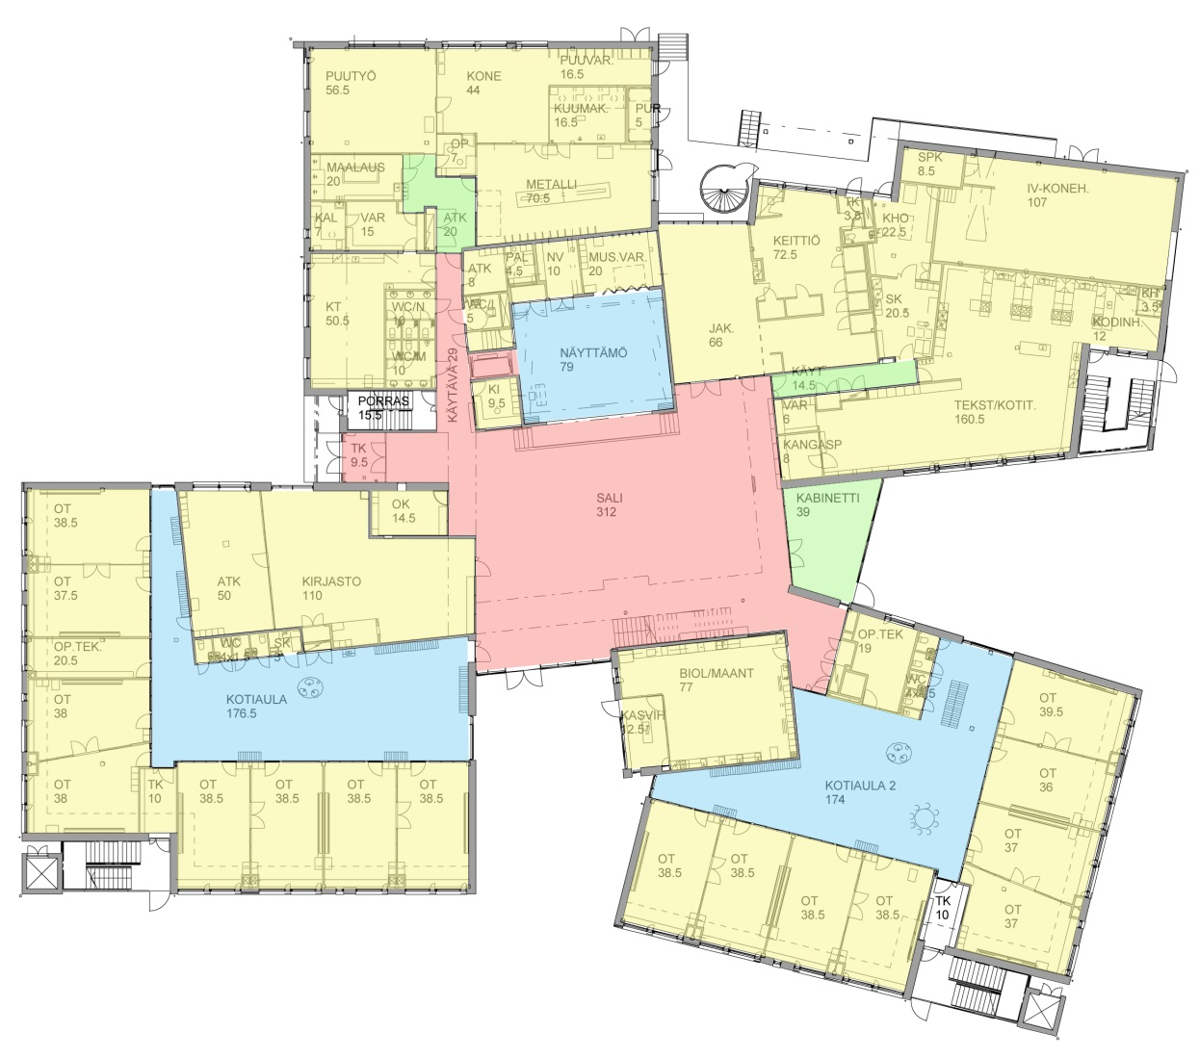
Spatial analysis of some new schools
Latokartanon koulu, Helsinki
PES arkkitehdit Oy

Slide 21
Spatial analysis of some new schools
Loppupäätelmä hankkeen vaiheesta
Analyysi menetelmä esitetyissä kuvissa on havaittu vajavaiseksi ja aineisto käyvään uudelleen läpi monitoiminnallisten tilojen kartoituksella ja erittelyllä, koska niiden on havaittu oleva yksi merkittävä selittävä tekijä pedagogisesti joustavien koulujen typologiassa. Mitä enemmän ja erilaisia monitoiminnallisia tiloja koulussa on sitä paremmin se taipuu erilaisiin opetustilanteisiin ja oppimisratkaisuihin. Kampustutkimuksessa on havaittu urbaanien kesantojen merkitys innovatiiviseuuden lisääjänä. Monitoiminnalliset tilat ovat vastaava mahdollistaja peruskouluympäristössä.

Slide 22
Kiitos
Pyhäjärvenkatu 5A
33200 Tampere
FINLAND
www.lumiset.fi
Heikki Luminen, arkkitehti SAFA
27.9.2012 Oulu

